Slide 1

NDRRMC – LOGISTICS SYSTEM
Sherine Jane Coronel | Joey Dela Cruz | Marc Adrian Jimenez

Slide 2
Overview
NDRRMC
Working Group
12 Clusters
Objective
Notes:
Shen

Slide 3
Purpose
Streamline processes
Scope
Data Gathering, System Design, System Development, Testing
Objective
Digitization
Notes:
Shen

Slide 4
Assumptions
ASSUMPTIONS | DESCRIPTION
AS-1 | The system will create a positive impact to the NDRRMC.
AS-2 | The system will replace the current manual system of the NDRRMC.
AS-3 | The system will reduce the paper works of the Council.

Slide 5
Constraints
CONSTRAINTS | DESCRIPTION
CO-1 | The client may not be available for meetings and presentations.
CO-2 | The Philippine Government’s allotted budget may not be sufficient for the modernization of the NDRRMC.
CO-3 | Deployment of the system to other platform is upon the client’s liability.

Slide 6
Risks
RISKS | DESCRIPTION
RI-1 | A project team member might resign due to personal matters.
RI-2 | Inconsistency of the project if the client unexpectedly changes the requirements.
RI-3 | If the contact person from the NDRRMC steps down or was replaced during the project development.

Slide 7
Project Deliverables
DELIVERABLE | RECIPIENTS | DELIVERY DATE | DELIVERY METHOD
Project Proposal | Office of Civil Defense | January 25, 2018 | Meeting
Project Plan | Project Team | January 25, 2018 | Meeting
Project Charter | Project Team / Office of Civil Defense | January 30, 2018 | Email
System Diagrams | Project Team / Office of Civil Defense | February 26, 2018 | Meeting
System Prototype | Office of Civil Defense | March 26, 2018 | Meeting
Quality Testing | Project Team | March 27, 2018 | Meeting
Project Status Report | Office of Civil Defense | April 4, 2018 | Email

Slide 8
Project Deliverables
DELIVERABLE | RECIPIENTS | DELIVERY DATE | DELIVERY METHOD
Final System | Office of Civil Defense | April 14, 2018 | Meeting
Quality Assessment Report | Project Team | April 11, 2018 | Email
System Manual | Office of Civil Defense | April 15, 2018 | Email
Final Documentation | Office of Civil Defense | April 19, 2018 | Meeting

Slide 9
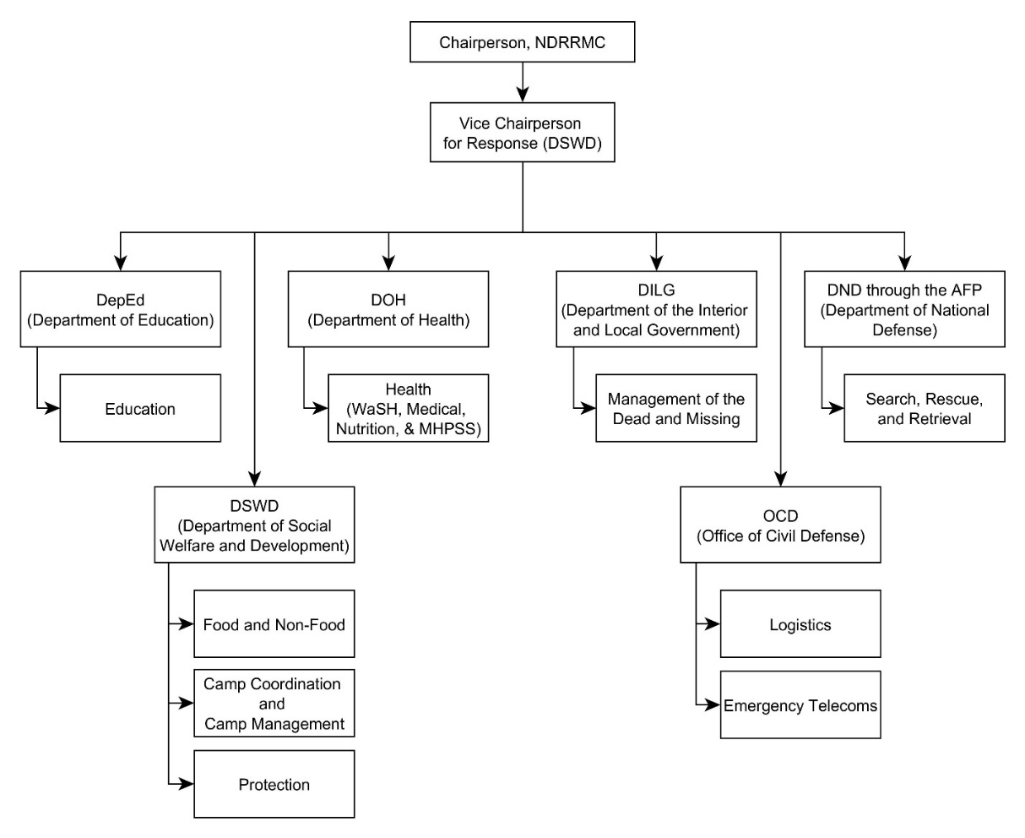
External Interfaces
Notes:
Shen

Slide 10
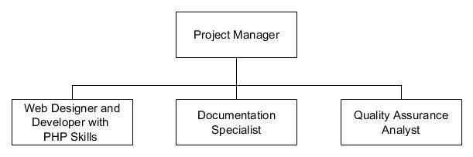
Internal Structure
Notes:
Shen

Slide 11
Estimates
WBS | TASK | HOURS | PARTICIPANTS | ESTIMATED COST
1 | INITIATION | 32 | IT Project Manager Web Designer and Developer with PHP skills Documentation Specialist Quality Assurance Analyst | ₱ 18,225.28
2 | PLANNING | 108 | IT Project Manager Web Designer and Developer with PHP skills Documentation Specialist Quality Assurance Analyst | ₱ 75,920.12
3 | EXECUTION | 344 | IT Project Manager Web Designer and Developer with PHP skills Documentation Specialist Quality Assurance Analyst | ₱ 141,566.96
4 | CLOSING | 32 | IT Project Manager Web Designer and Developer with PHP skills Documentation Specialist Quality Assurance Analyst | ₱ 10,577.60
ESTIMATED TOTAL |  |  |  | ₱ 246,289.96
Notes:
Jobie –
>Task - Divided into 4 major phases (Initiation, Planning, Execution, Closing)
>Participants for each phases are: IT Project Manager, Web Designer and Developen, Docu Specialist, QA Analyst.
The number of hours are based on the gantt Chart which will be show later
Estimated cost – Multiplying the number of hours to the salary per hour of each role and getting the sum

Slide 12
Staffing
ROLE | DURATION
IT Project Manager | 300 hours
Web Designer and Developer with PHP skills | 376 hours
Documentation Specialist | 156 hours
Quality Assurance Analyst | 260 hours
Notes:
Jobie
Working days – Monday – Friday, with 8 hrs per day
>Each role must meet the required skills to be hired.
IT Project Manager – Strong leadership skills, good communication skills, have time management
Web Designer – Knowledge in Yii2, Good problem solving skills
Docu – Strong vocabulary prowess, has basic knowledge in using MS Office Tools
Quality – High Critical thinking skills, Good in understanding statistics
>Duration – based sa gantt chart

Slide 13

Procurement (Human Resources)
IT Project Manager
Web Designer and Developer with PHP skills
Documentation Specialist
Quality Assurance Analyst
Notes:
Jobie
4 Procurement Human resource, Documentation, Software development, Hardware
Proj Manager – Keeping track of the progress of the team. 145,305.92 based on pay scale
Web Designer – Need because this project is software implementation, system designer will satisfy the requirements the client
Docu – Compile all written materials that is essential to the project, hand to project sponsor.
Quality – QA is needed because Outputs of the project needs to undergo quality control for avoid anomalies

Slide 14
Procurement – Documentation
Office 365 Business
yEd Graph editor
MySQL Workbench
MS Project
Notes:
Jobie
Office 365 – Used for communication of the client and project team, for documentation
yEd – to illustrate diagrams needed for the project, such as Data flow Diagram
MySQL – Visualization of the database, production of SQL Script, Entity Relationship diagram (ERD)
MS Project – Gantt Chart

Slide 15
Procurement – Software Development
XAMPP
MobaXterm
PuTTYgen
Sublime Text
Firefox Quantum
Github Desktop
Amazon Web Services
Notes:
Jobie
XAMPP – HTTP Server MariaDB Database. Used to mimic client-server environment via localhost
MobaXterm – Used as the SSH terminal connecting to the EC2 Instance when deploying the system to a cloud platform
PuTTYgen – convert private keys to be used to connect to the EC2 Instance
Sublime Text – Help the project developer to easily navigate through the project folder and edit the source codes
Firefox – browser that will be used to in deploying the system as a web application
Github Desktop - centralized storage or Repository of all the related files of the project.
Amazon – Under this is the Elastic Compute Cloud or EC2, which will be used to host the system in cloud. Includes t2.micro and 1TB SSD Storage

Slide 16
Procurement – Hardware
Lenovo IdeaPad 510s

Slide 17
Project Staff Training
TRAINING | TAKING THE TRAINING
PHP Training | Web Designer and Developer
Amazon Training Course | Web Designer and Developer
Notes:
Jobie
PHP – Improve skills in web development, specifically in language PHP
Amazon – Improve skills in cloud admin using amazon web services

Slide 18
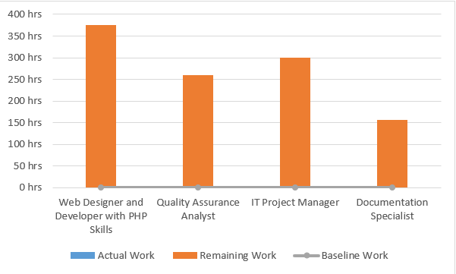
Resource Allocation
Notes:
Marcla
Listed are the following positions needed for the project, along with the start and end of their work, as well as the total number of hours they’ll be spending for the project.

Slide 19
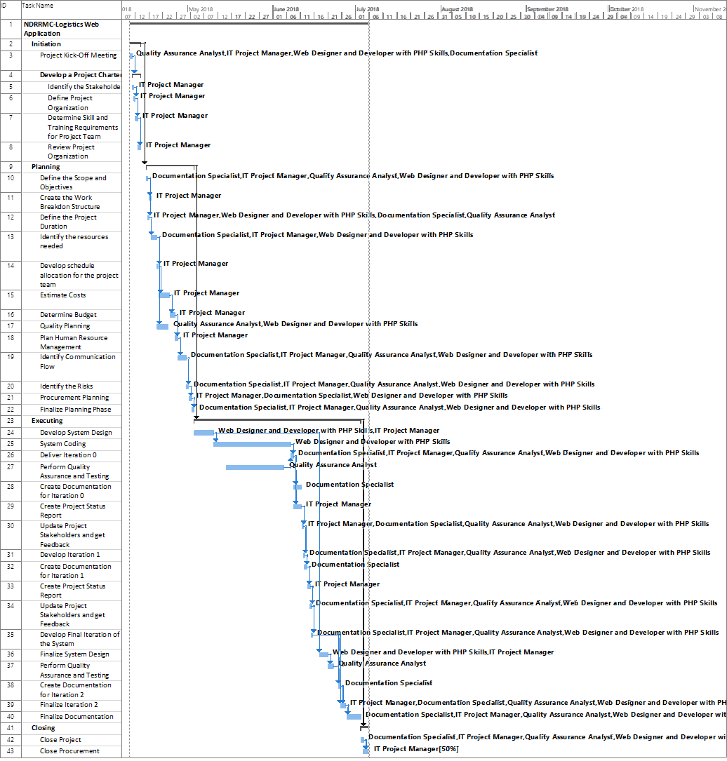
Schedule Control
Notes:
Marcla
The process model to be used for this project is the Scrum Agile Methodology, and that being used is reflected in the Gantt Chart, as we have a total of 3 iterations during the executing phase
The schedule for the project is divided into 4 phases; Initiation, Planning, Executing, and Closing
The initiation phase is focused on the project charter (main gyst of the project)
The planning phase for the internal resources needed by the team
The executing phase, for the software development, and closing to end it all.

Slide 20
Budget Plan - Human Resource
ROLE | HOURLY SALARY | NO. OF HOURS | TOTAL (HOURLY SALARY * NO. OF HOURS)
IT Project Manager | ₱ 477.98 | 300 hours | ₱ 145,305.92
Web Designer and Developer with PHP Skills | ₱ 128.13 | 376 hours | ₱ 48,689.40
Documentation Specialist | ₱ 101.60 | 156 hours | ₱ 16,256.00
Quality Assurance Analyst | ₱ 136.51 | 260 hours | ₱ 36,038.64
HUMAN RESOURCE TOTAL |  |  | ₱ 246,289.96
Notes:
Marcla
As stated earlier, these are the following positions needed for the project, and in this table, the total budget needed for the human resources are totaled.

Slide 21
Budget Plan – Staff Training
TRAINING | TRAINING FEE | TOTAL
PHP Training | ₱ 10,000.00 | ₱ 10,000.00
Amazon Training Course | ₱ 36,241.12 | ₱ 30,928.10
STAFF TRAINING TOTAL |  | ₱ 40,928.10
Notes:
Marcla

Slide 22
Budget Plan – Documentation
TOOL | MONTHLY FEE | NO. OF MONTHS | TOTAL
Office 365 Business | ₱ 517.77 | 3 | ₱ 1,553.31
DOCUMENTATION TOTAL |  |  | ₱ 1,553.31
Notes:
Marcla
Office365 is a package of tools that will be useful for the projects documentation, and presentation to the clients. The Office365 contains MS Word, MS Excel, MS Powerpoint, etc. Pricing are gathered from their website. It is originally in USD, and was converted to PHP for easier computation

Slide 23
Budget Plan – Software Development
TOOL | SOFTWARE PRICE | TOTAL
MobaXterm | ₱ 3,609.08 | ₱ 3,609.08
Sublime Text | ₱ 4,166.67 | ₱ 4,166.6 7
Amazon Web Services | ₱ 6,500.00 | ₱ 6,500.00
SOFTWARE DEVELOPMENT TOTAL |  | ₱ 14,275.75
Notes:
Marcla
These are the following tools (with cost) that are needed for the project. MobaXterm that let’s us connect to the deployed Amazon Web Services server, and Sublime Text that will serve as the main text editor for the system. It is originally in USD, and was converted to PHP for easier computation.

Slide 24
Budget Plan – Hardware
TOOL | UNIT PRICE | QUANTITY | TOTAL (UNIT PRICE * QUANTITY)
Lenovo IdeaPad 510s | ₱ 64,995.00 | 2 | ₱ 129,990.00
HARDWARE TOTAL |  |  | ₱ 129,990.00
Notes:
Marcla
The following are the hardware requirements needed for the project, 2 laptops, for the prototyping and the documentation.

Slide 25
Contingency Plan
OVER ALL COST | EMERGENCY FUND PERCENTAGE | CONTINGENCY FUND (OVER ALL COST * 0.15)
₱ 433,037.12 | 15% | ₱ 64,955.57
TOTAL COST | CONTINGENCY FUND | OVERALL BUDGET (TOTAL COST + CONTINGENCY FUND)
₱ 433,037.12 | ₱ 64,955.57 | ₱ 497,992.69
Notes:
Marcla
Contingency – for the unforeseeable events.
The project team decided to add 15% to the over-all cost for the contingency budget that will be used during unpredicted events that needs monetary actions.

Slide 26
Risk Management
RISK | DESCRIPTION | RISK OWNER | TRIGGER | POTENTIAL RESPONSES | IMPACT
Client Unavailability | Client is not available to meet with the team | Office of Civil Defense | Conflict of schedule | Reschedule meeting | HIGH
Delayed Project Schedule due to Unexpected Suspensions | The Philippine Government suddenly announces non-regular work suspensions, such as the ASEAN Summit, Pope Visitation, etc. | Project Manager | Unexpected suspensions are declared. | Encourage working overtime. Adjust the deadlines. | MEDIUM
Unexpected changes in requirement | The client demanded a certain change in the system | Project Team | The client is not satisfied with the system | Communicate with the client with regards his dissatisfaction towards the system. | MEDIUM
Notes:
Jobie
Impact – are based on the general analyzation of the project team
Unexpected suspensions such as, ASEAN Summit, Pope Visitation, Typhoons
Communicate with the client with regards his dissatisfaction towards the system.

Slide 27
Risk Management
[MAJ1]Delayed Project due to what????
If member related, wag ilalagay
RISK | DESCRIPTION | RISK OWNER | TRIGGER | POTENTIAL RESPONSES | IMPACT
Unexpected emergency leave of an employee | The employee has an emergency and needs to be absent | Project Manager | Employee experiences unexpected emergencies (ex. Sickness) | Employee needs to work overtime Assign other employee to do his tasks Avoid assigning a role to only one employee | LOW
Inflation rate increases | Increase in general price level of goods and services in the economy that may affect the budget computation | Project Team | Demand of goods or services increases. | Use the allocated contingency fund. | HIGH
Notes:
Jobie
Emergencies – Sickness, death of a relative
Inflation rate increases – shortage of budget
Happens when goods and services suddenly increase and affects the budget computation

Slide 28
Process Model
[MAJ1]Delayed Project due to what????
If member related, wag ilalagay
1. Plan
2. Define Requirements
5. Initial Testing
6. Configure & Implement
7. Client Testing
3. Design
4. Develop & Implement
Notes:
shen

Slide 29
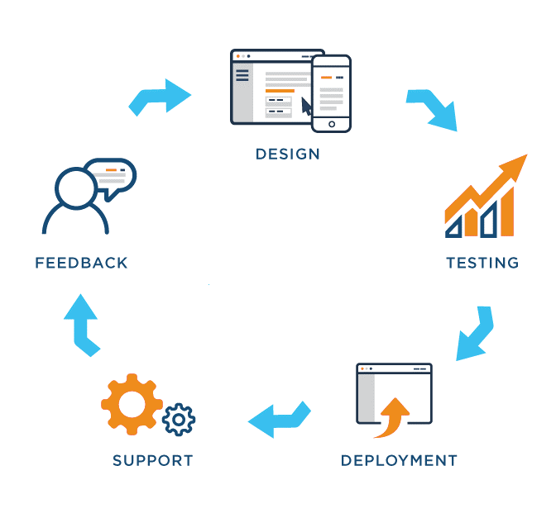
Quality Assurance Plan
[MAJ1]Delayed Project due to what????
If member related, wag ilalagay
Notes:
shen/marcla
The illustration is the Quality Assurance Process suggested by the project team. This is to further increase the quality of the output.

Slide 30
Product Acceptance
[MAJ1]Delayed Project due to what????
If member related, wag ilalagay
REQUIREMENT | TESTING MECHANISM
Project Management Plan | Static Testing – to be done by Quality Assurance Team
User Management Module | Dynamic Testing – to be done by Quality Assurance Team
Procurement Module | Dynamic Testing – to be done by Quality Assurance Team
Transportation Module | Dynamic Testing – to be done by Quality Assurance Team
Notes:
shen

Slide 31
Configuration Management
[MAJ1]Delayed Project due to what????
If member related, wag ilalagay
ROLE | TOOL/METHOD
Project Manager | Meetings, Emails
Software Developer | Yii2
Quality Assurance Tester | Github
Notes:
Jobie
Configuration Management ensures that the descriptions of the project’s products are correct and complete. And each role are responsible when a change is needed.
Proj Manager – Coordinate with the project team and client to discuss the changes
Software developer – Changes the system based on the requirement of the client
QA – ensures changes are updated, bugs are identified, and stored in the repository for version control

Slide 32
Process Improvement
Reportico Module
Other Platform
Map Routing
User Profile
Stand Alone System
Notes:
All hehe
A Reportico module wherein the system can instantly produce an inventory report using the data coming from the database
Expansion of the system to the other platform (i.e, mobile application)
A map routing algorithm that has higher reliability rate during disaster
Customization of the user’s profile
Integration of stand-alone NDRRMC cluster systems.

